Slide 1
Evaporator Design

Slide 2
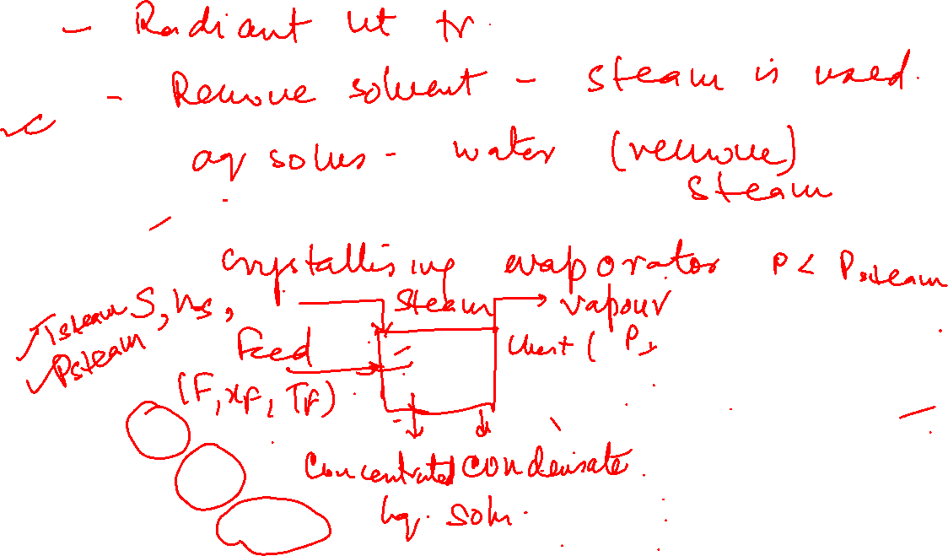
Boiler
Vaporiser
Evaporator
A solvent is boiled out of a solution to concentrate a product.
In most cases, solvent is water & product is a concentrated solution or in some cases, slurry
Reboiler
Heating medium - “steam”
Product of evaporation - “vapour”
Customarily steam refers to water vapour
& vapour is vapour from any liquid, not necessarily water.

Slide 3
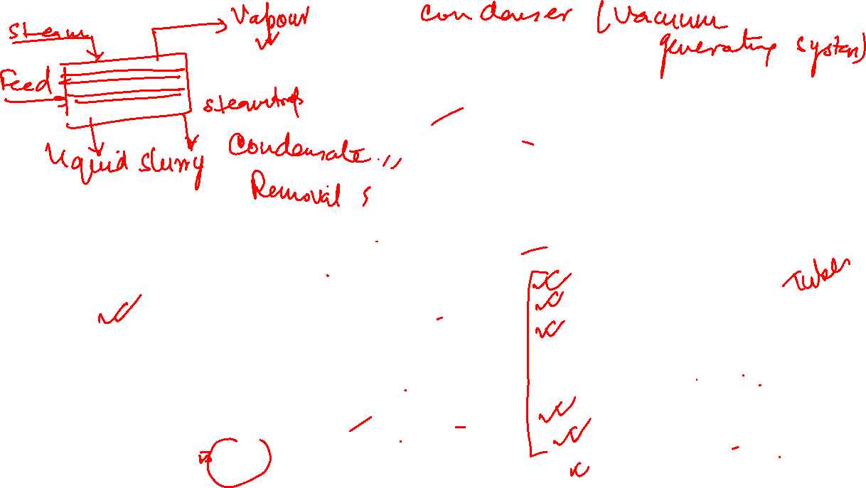
Limitations
long residence time
low heat transfer coefficient
low heat transfer area per unit volume occupied by the feed
high tendency of fouling (product movement by natural circulation only)
high boiling point of product at the tank bottom (due to liquid head)
Batch Pan evaporator
Steam jacketed vessel heated with vapour or liquid heating medium
Components
Evaporator body (vessel)
Arrangements for supplying heat
Vapour-liquid separator prevents entrainment, contamination of the condensed vapour and fouling /corrosion of surface on which vapour condenses
Condensate removal
Auxiliaries for pulling of vacuum
Recirculation of liquid, if reqd

Slide 4

Foaming and Entrainment
Entrainment - carryover of liquid droplets by exiting vapour
- Considerably reduced by providing sufficient disengagement height (1.8 m above boiling liquid) - De-entrainer
Foaming
- Due to colloids, surface tension depressants, finely divided solids, dissolved air or gases in the liquid
- Defoaming techniques use chemical, thermal, or mechanical methods
Mechanical methods of reducing entrainment
(a) upturned pipe, (b) deflector, (c) tangential separator

Slide 5
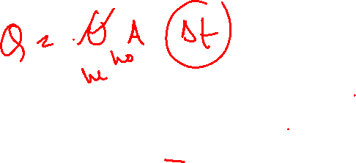
Phenomena affecting performance and operation of evaporators
Depend on the process fluid
Affects choice and design of evaporator
Salting, Scaling and Fouling
Scaling - Deposition and growth of solid on heat transfer surface
- Happens for solutes whose solubility decreases with increase in temperature/ irreversible chemical reaction
Salting -Deposit and growth of material on cooler surfaces
- Common in crystallising evaporators as crystal solubility increases with temperature
Fouling - Deposition other than salts and scales on heat transfer surface
- Due to corrosion, solid matter entering with feed and deposits from condensing vapours
Corrosion and erosion
High liquid & vapour velocities encountered
Presence of solids in suspension
Necessary concentration differences.
Splashing losses
Insignificant if reasonable disengagement height provided above liquid level.
Height depends on vigour of boiling
Usually 2.4 to 3.5 m in short tube vertical evaporators

Slide 6
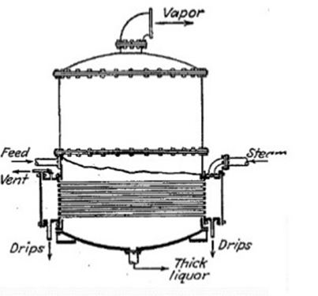
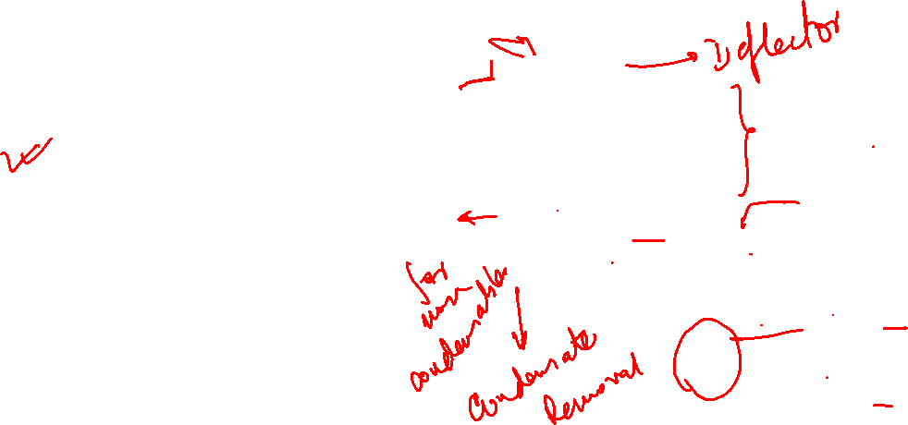
Continuous Evaporators three main types based on nature of circulation -
Natural circulation units
Forced circulation units
Film-type units
In natural-circulation evaporators, circulation of
liquid effected by employing a short length of tube.
Horizontal tube Evaporator
Relatively cheap and easy to install
Non condensables do not blanket heat transfer surface
Require low head room
No scaling inside tubes So smaller tube diameters
Not suitable for scaling liquids/liquids depositing solids outside tubes
Not suitable for handling liquors that crystallise
Used when final product is liquor (industrial sugar syrup)
Not used for viscous liquors

Slide 7
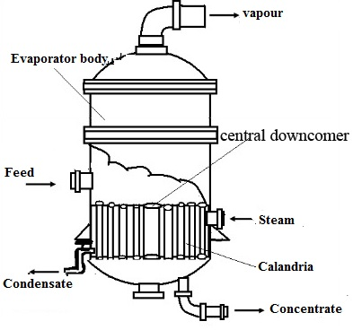
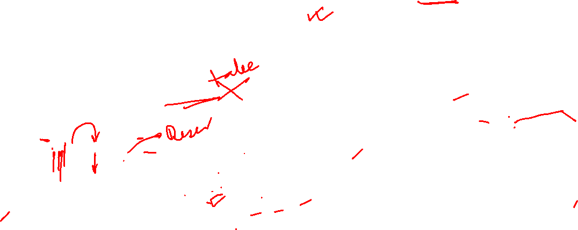
Short tube evaporator with calandria
Central downtake
- Area between 75-150% of total tube cross-sectional area
- Heating tubes - 37 to 75 mm in diameter and 1 to 2 m long (length/diameter- 20 and 40)
- Fixed between tube sheets bolted to flanges
Low head-space
Fairly high U with low viscous liquids (upto 5–10 cP)
Relatively inexpensive to manufacture
Suitable for liquids with moderate scaling tendency since product on tube side
Not used for heat sensitive products/crystalline products
Due to better circulation of liquor in tubes, used in salt and sugar industry where throughput large

Slide 8
Typical calandria baffling
Arrows indicate direction of steam flow
Condensate drain
Steam inlet
Bleed
Downtake
Shaded area indicate location of non-condensable bleed points

Slide 9
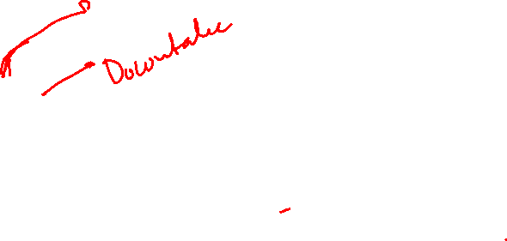
Basket type evaporator
Tube bundle suspended in the body, thus forming an annular downtake
Heating unit easily removed for cleaning and repairs
Ensures that crystals formed in the downtake do not break up

Slide 10
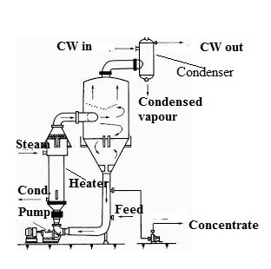
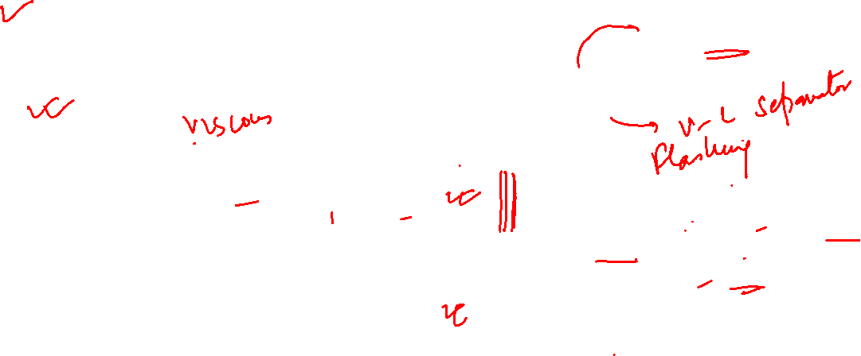
Evaporator with external heating – forced circulation
Higher liquor velocity through tubes, so high liquid-film transfer coefficient
Typically velocity in the tubes - 1 m/s for salt evaporators containing less than 5% solids, ≈3m/s for lower concn.
Also reduces fouling, so maintaining capacity and reducing downtime.
High operating cost
Liquor introduced either at the bottom and pumped through the calandria,
or introduced in the separating section.
In most units, the hydrostatic head of liquid suppresses boiling in the tubes and boiling (flashing) occurs only in the separator.
Heating surface relatively immune to salting and scale formation.
High heat transfer rates even with increasing viscosity of liquid, enable formation of more concentrated product
Can be made smaller and cheaper than those natural circulation evaporators (preferred where SS/expensive alloys such as Monel are used)

Slide 11
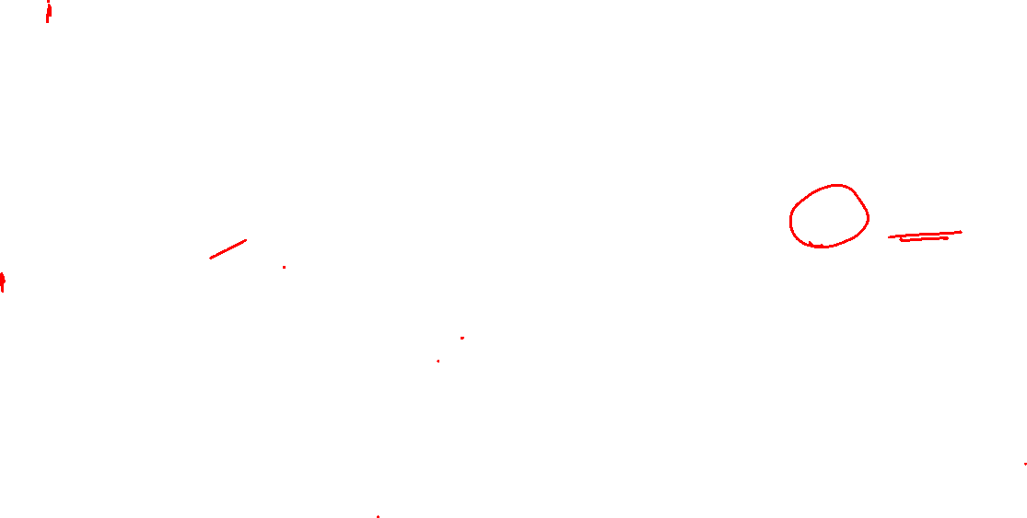
Climbing and falling film evaporator
Resembles vertical tube evaporator in that liquid inside tube and steam outside.
Product forms thin film only on the heat transfer surface and does not occupy the entire tube cross section.
Low holdup greatly reduces residence time within heat exchanger.
So ideal for heat sensitive materials like pharmaceutical, food and dairy products
Allows operation with as low as 3.5⁰C steam-to-product temperature difference and minimises hot spots.
Film evaporators can have rising film, falling film and a combination of rising/falling film design.
Both tubular and plate configurations used.
Used when a high ratio of evaporation to feed is required resulting in a viscous product

Slide 12
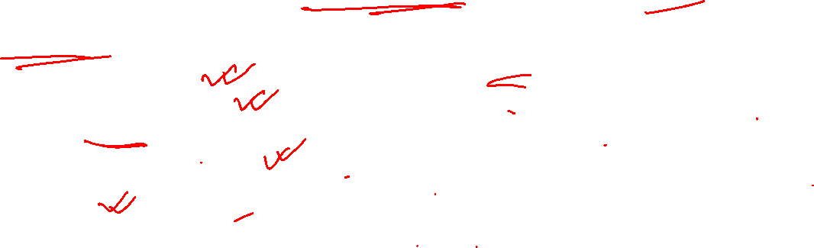
Evaporator Design
Properly designed evaporator must, at a minimum:
effectively transfer heat at a high rate with minimum surface area so that it is economic for installation, operations and maintenance
effectively separate vapour from liquid concentrate
meet solvent evaporation capacity
meet product quality (concentration)
be energy efficient by effective use of steam (multiple-effect evaporation/vapour recompression)
minimize fouling of heat transfer surface
Material of construction adequate to minimize corrosion
Three principal elements in design
Heat transfer
Vapour-liquid separation
Energy utilisation

Slide 13
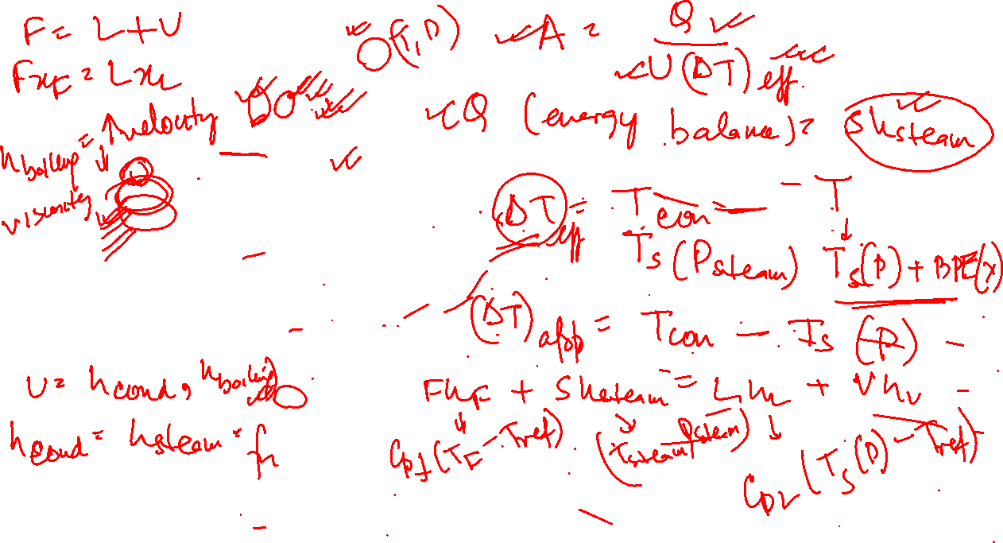

Slide 14
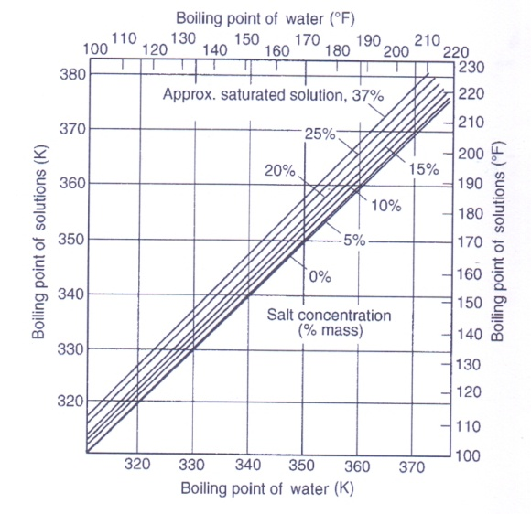
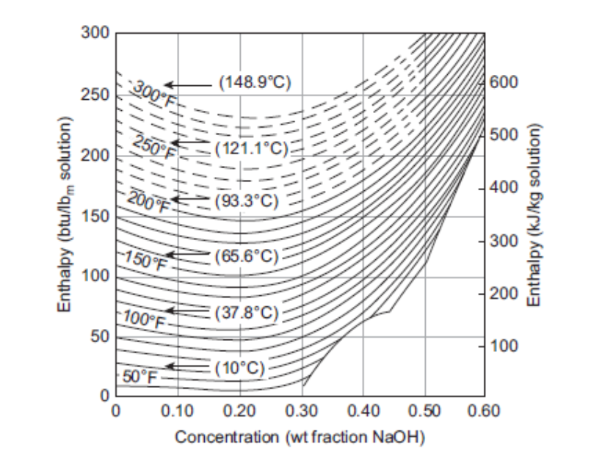
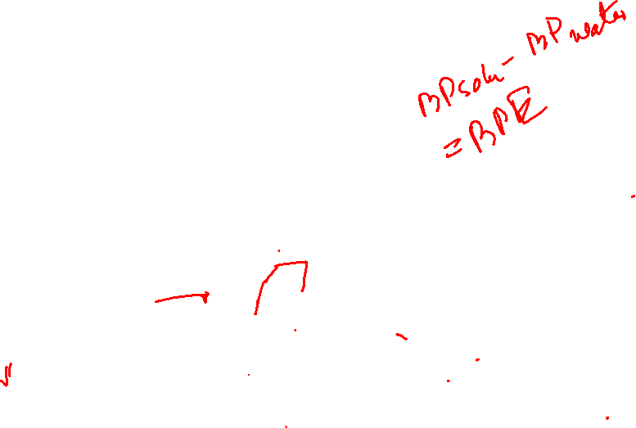
Enthalpy plots
Duhring Plot for sodium chloride solution

Slide 15
Relationship between boiling point (BP), temperature drop and overall heat transfer coefficient in vertical tube evaporators for 30”diameter evaporator with 24 numbers of 2” diameter 48”long tubes.
U and ΔT_{eff} are in W/m²K and ºC respectively
Constants to be used in Equation for predicting U
Boiling Point(ºC) | a | b | c | d
100 | 0.4530 | 720.2609 | 12.7327 | 0.9524
75 | -0.4856 | 684.4337 | 22.3611 | 1.1038
60 | 0.2090 | 509.0018 | 26.5472 | 1.2798
50 | 0.3641 | 687.8854 | 83.2172 | 1.0207

Slide 16
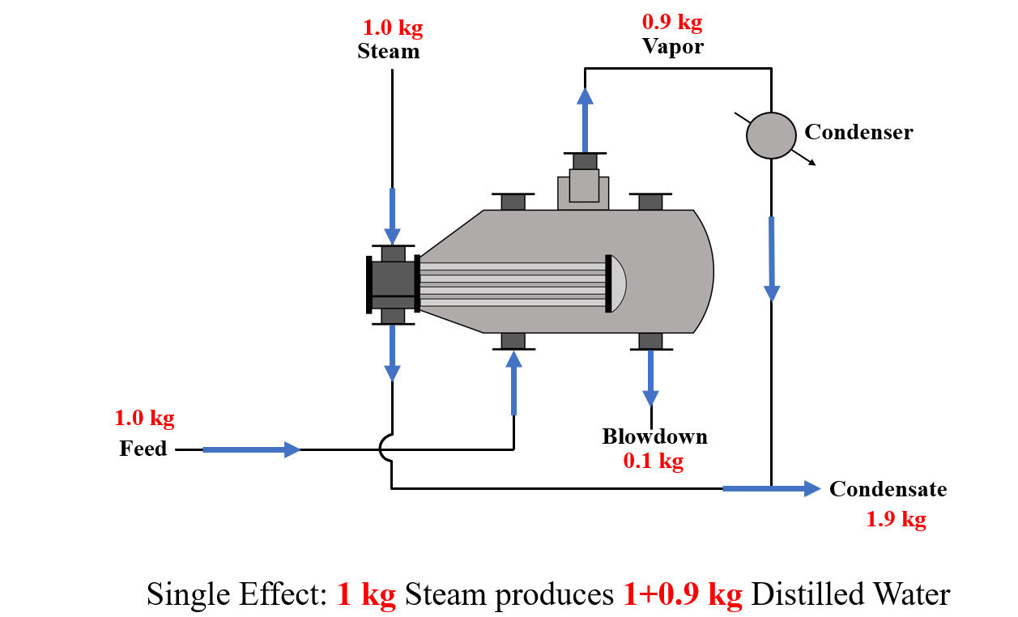
Production of distilled water in power plants
Can be improved by use of multiple effects

Slide 17
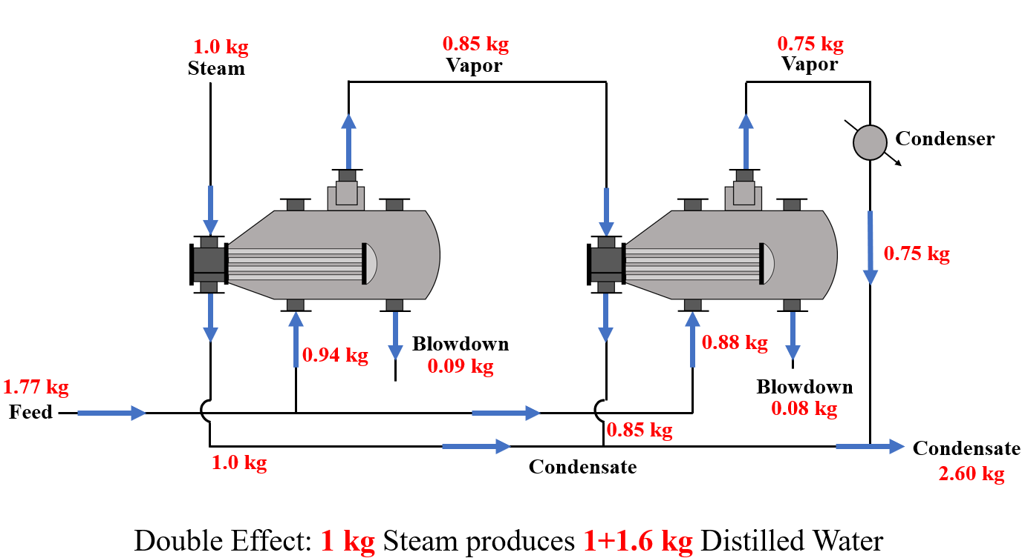

Slide 18
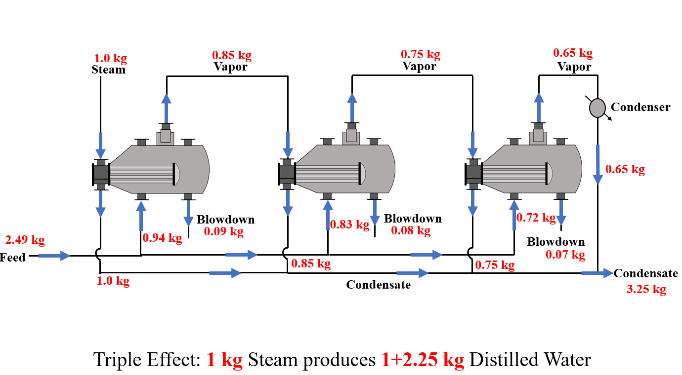

Slide 19
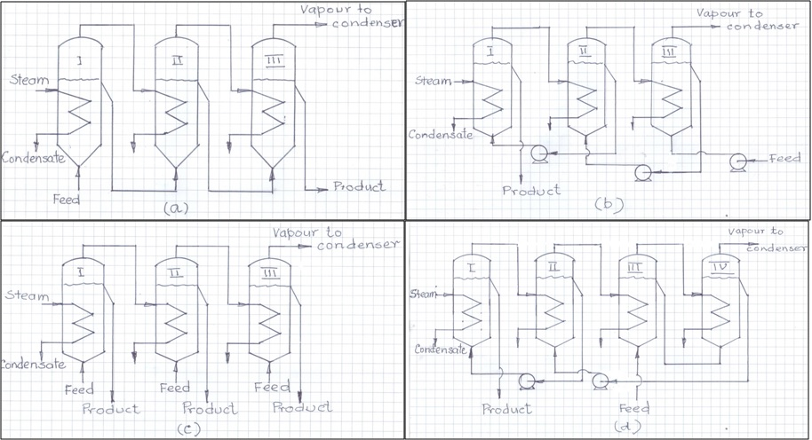
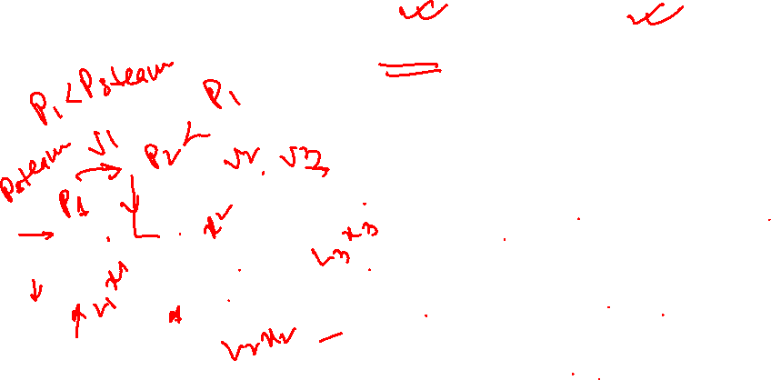
Economy for an evaporator = kg solvent evaporated per kg steam used.
Can be improved by use of (a) multiple effects and (b) vapour recompression.
Different configurations of multiple effect evaporators
Backward feed
- Cold feed
- High product viscosity
Forward feed
Backward feed
Forward feed
- Hot feed
- Product with scaling tendency at higher temperature
- Product sensitive to higher temperature
Parallel Feed
Mixed feed

Slide 20
Generalised configuration of N-effect forward feed evaporator

Slide 21
Plot for arriving at optimum number of effects

Slide 22
Boiling Point Elevation in Multiple Effect Evaporators

Slide 23
Design objective
Meeting the final product concentration with high steam economy
Multiple effect evaporator design also aims at arriving at design with (nearly) same heat transfer area for each effect-
Indirect way to economise on fabrication cost and minimise inventory cost by holding common spares.
Design deliverables
To summarise, process design output gives the heat transfer areas (A_{i}, i=1,...,N) and also includes values of all variables which are not specified as design input.
Process design output for chosen type of multiple-effect evaporator –
Heating steam requirement – estimated from mass and energy balance
Heating surface requirement – estimated from heat transfer equations
Estimated temperature in each effect
Amount of vapour leaving the last effect and going to the condenser

Slide 24
Design Problem
Design a feed forward evaporator to concentrate a feed of x wt.% glycerol solution available at a temperature of 35°C to y wt.% of finished product. The feed flow rate is z kg/hr. Steam is available at 103.66 kPa (abs.) and a vacuum of 92.5 mm of Hg (abs.) is maintained in the last effect. The overall heat transfer coefficient in W.m⁻².ºC⁻¹ are estimated to be 2350 and 1250 if a 2 effect system is used. Specific heat of pure gylcerine is 2.42 kJ/(kg.ºC).. Heat losses by radiation and entrainment may be neglected. Condensate leaves each effect at its saturation temperature.

Slide 25
Group Numbers | x wt% | y wt% | z kg/hr
1 | 20 | 60 | 50000
2 | 20 | 65 | 50000
3 | 20 | 70 | 50000
4 | 20 | 75 | 50000
5 | 20 | 60 | 52000
6 | 20 | 65 | 52000
7 | 20 | 70 | 52000
8 | 20 | 75 | 52000
9 | 20 | 60 | 55000
10 | 20 | 65 | 55000

Slide 26
Group Numbers | x wt% | y wt% | z kg/hr
11 | 25 | 65 | 50000
12 | 25 | 70 | 50000
13 | 25 | 75 | 50000
14 | 25 | 80 | 50000
15 | 25 | 85 | 50000
16 | 25 | 65 | 52000
17 | 25 | 70 | 52000
18 | 25 | 75 | 52000
19 | 25 | 80 | 52000
20 | 25 | 85 | 52000
21 | 25 | 85 | 55000

